Slide 1

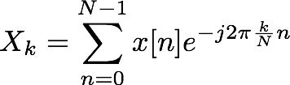
Introduction: FFT
Fast Fourier Transform
Method to compute Discrete Fourier Transform (DFT) for evenly-spaced frequency samples
DFT is sampling of Discrete-Time Fourier Transform (DTFT)
DTFT:
DFT:
FFT:
(continuous frequency)
(discrete frequency)
Same as DFT: just a specific implementation

Slide 2
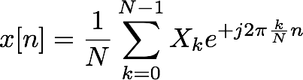
Introduction: FFT
Reconstructing signal from DFT/FFT
Inverse Discrete Fourier Transform (IDFT/IFFT)
DFT:
IDFT:
Notice: N time samples N frequency samples
Two different perspectives on same signal
Given signal length M, can exactly reconstruct from FFT of length N ≥ M
What happens with an FFT of length N < M?
Aliasing

Slide 3
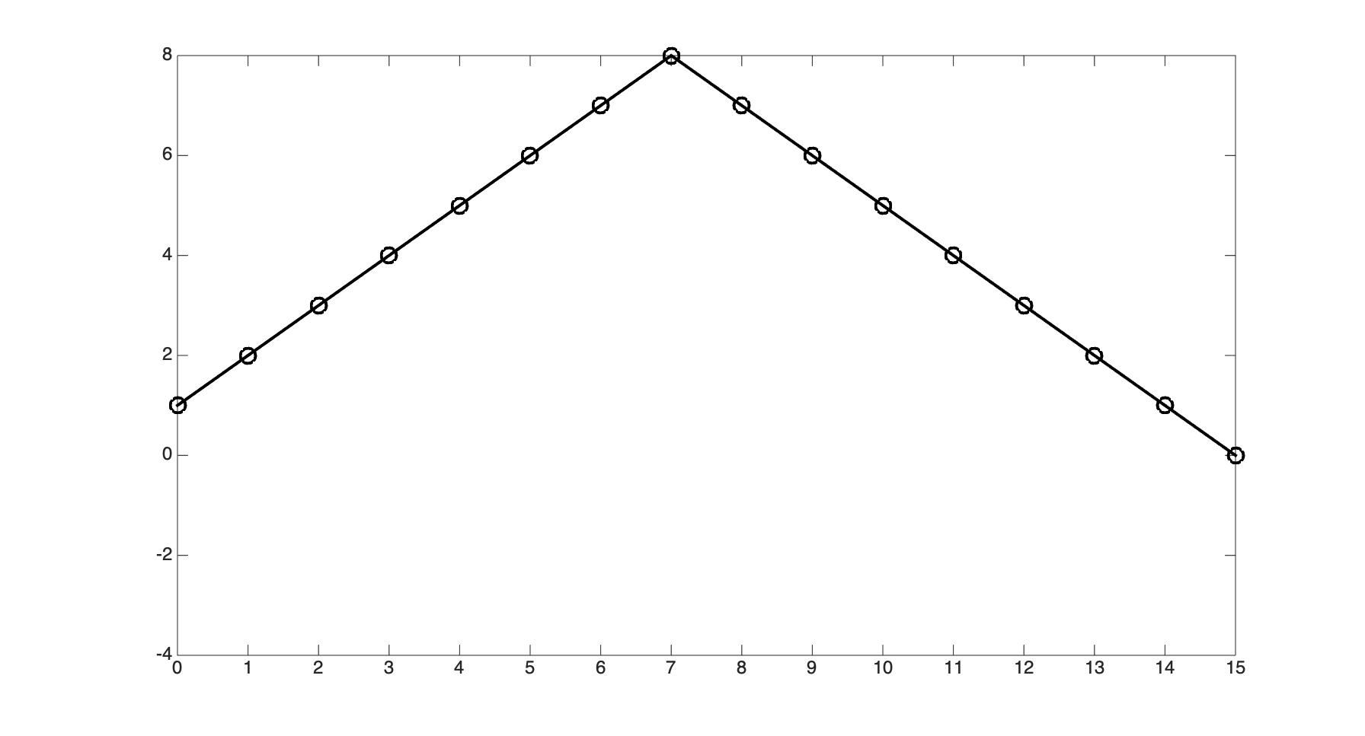
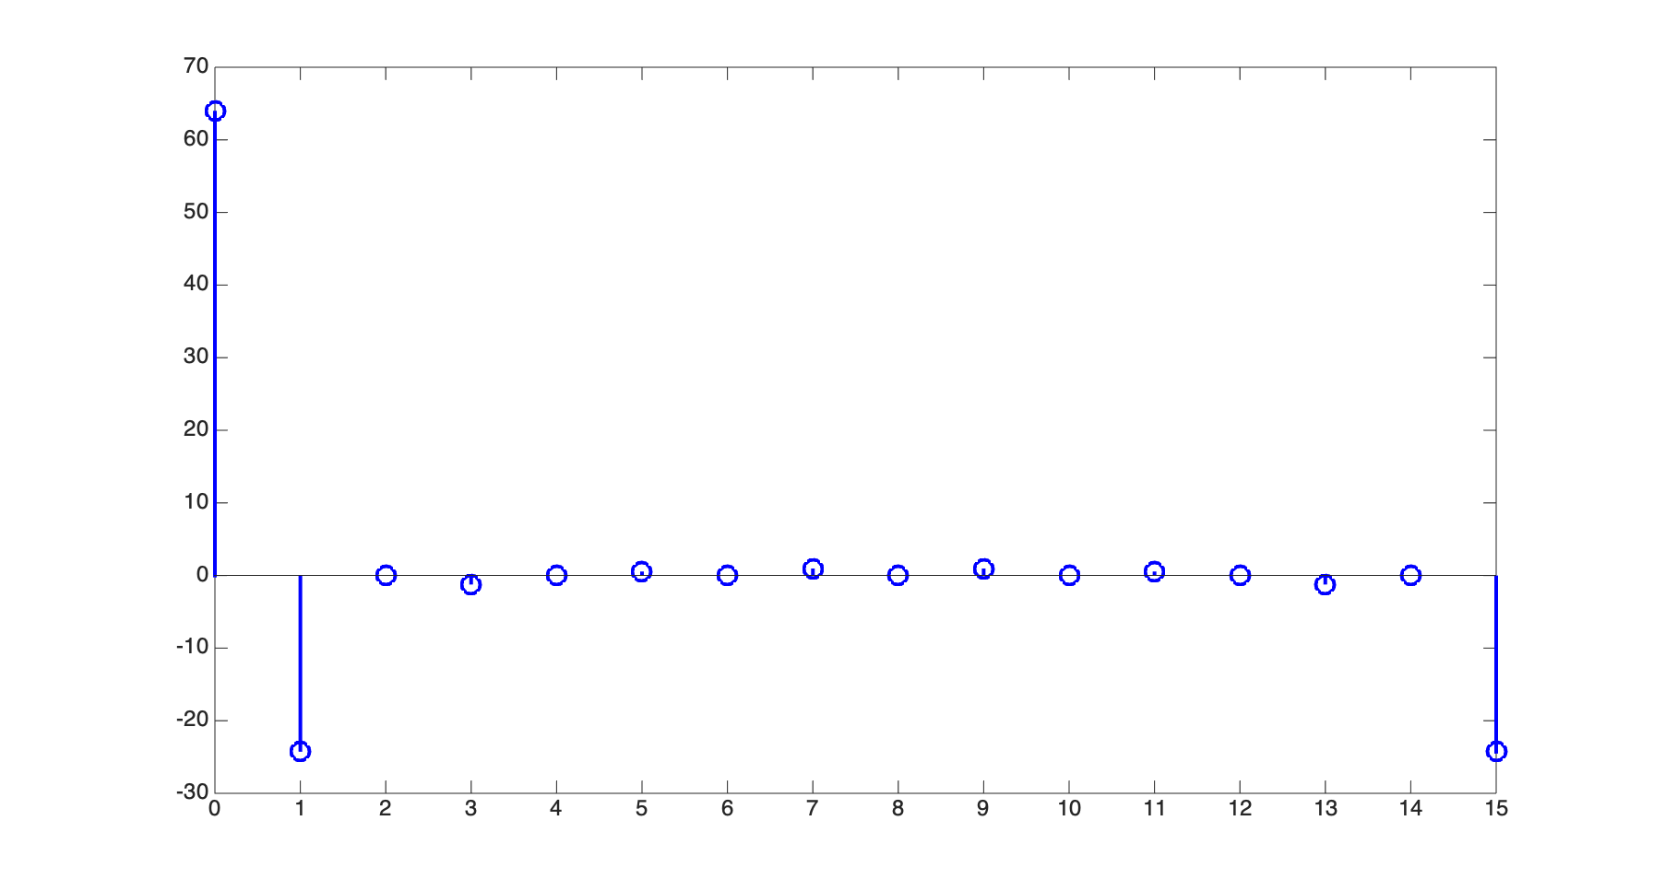
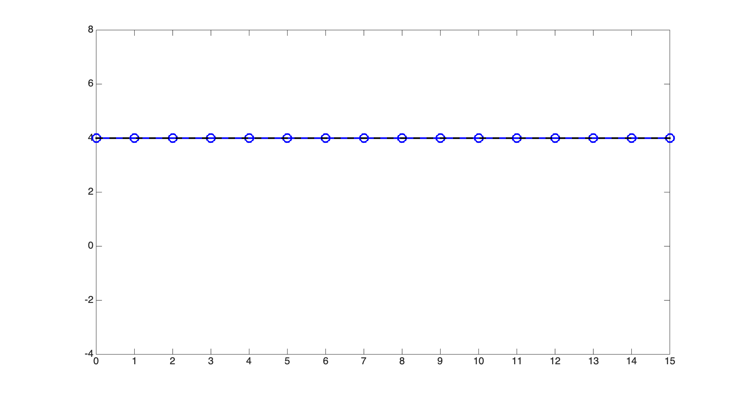
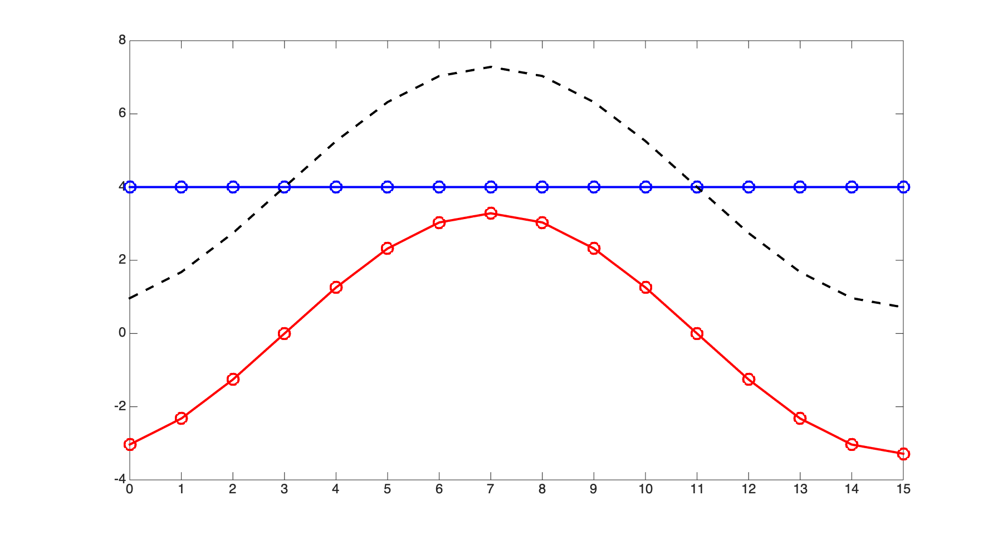
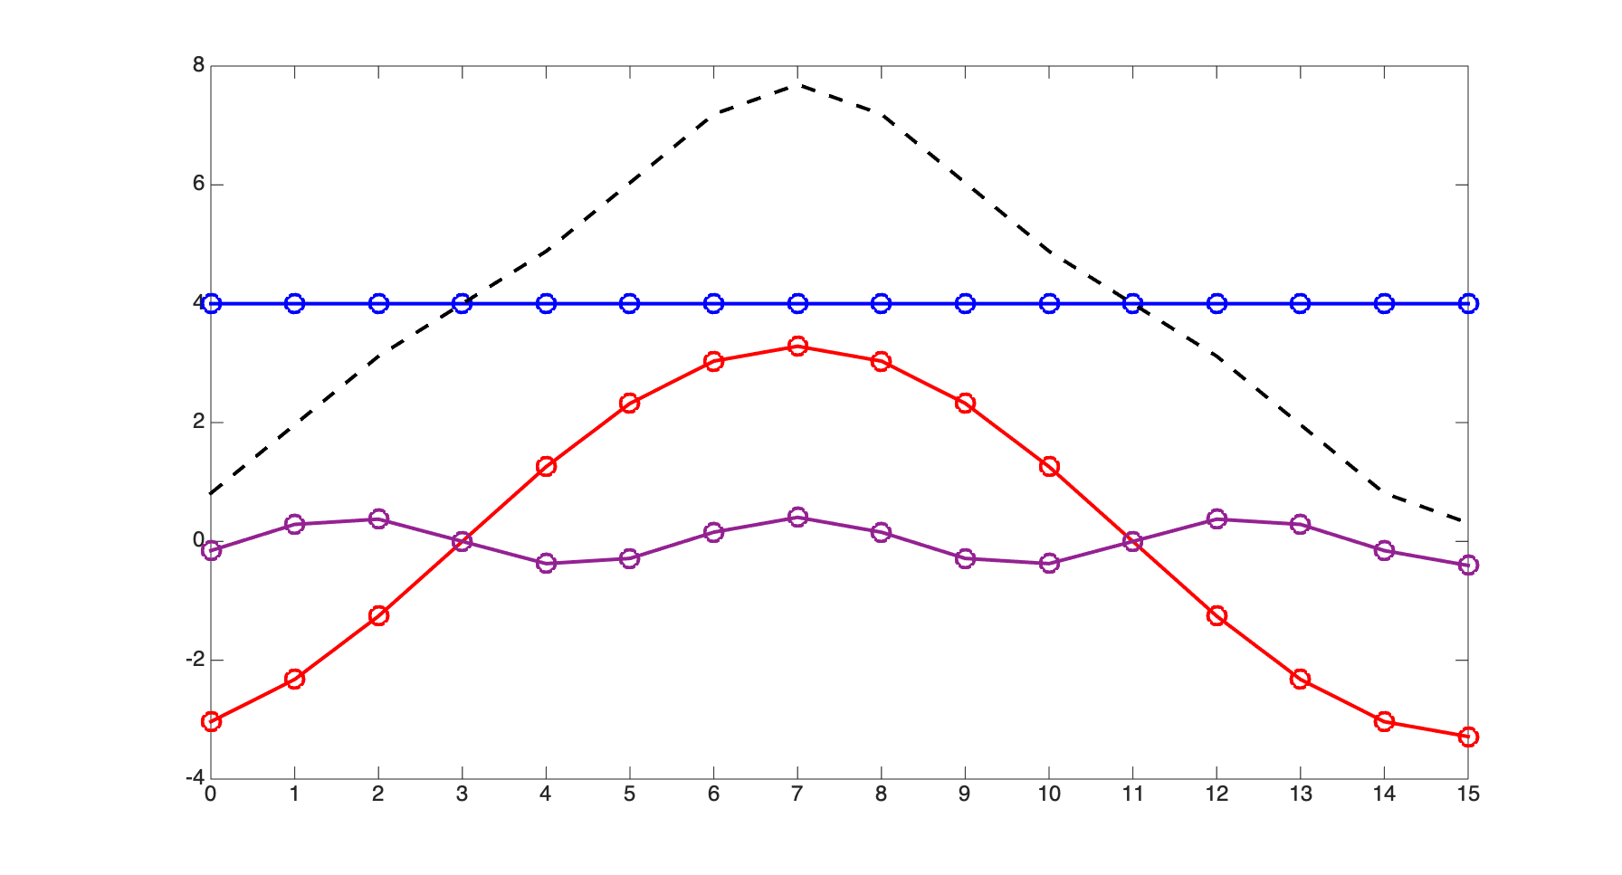
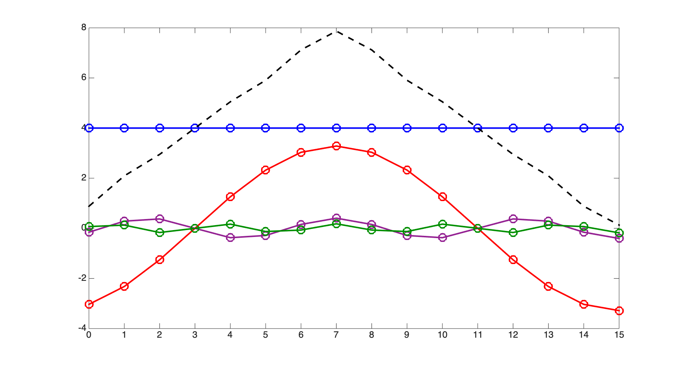
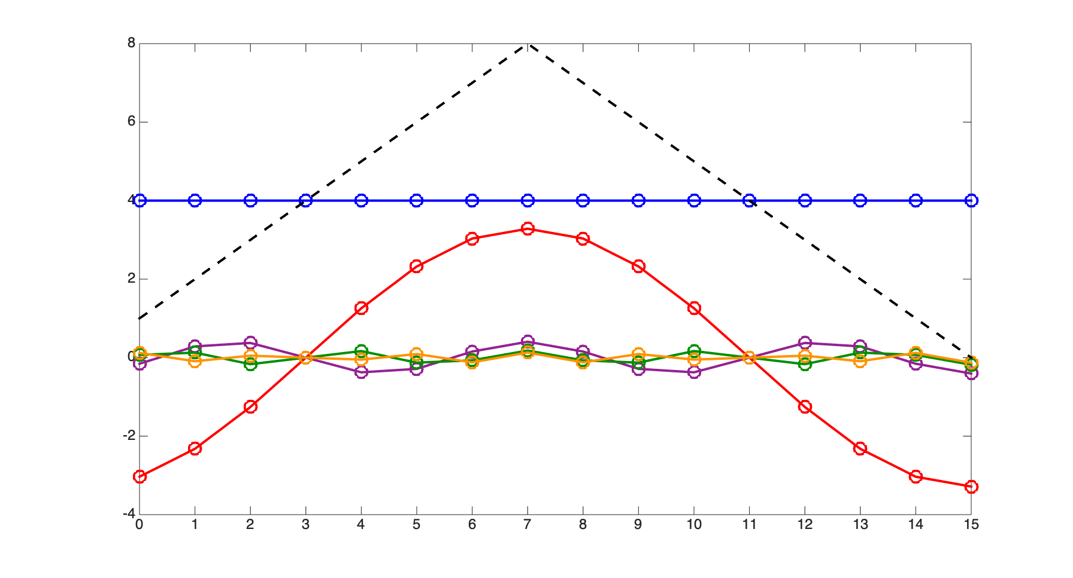
The Fast Fourier Transform
Most common use of block-based processing: the Fast Fourier Transform (FFT)
Efficient computational algorithm for calculating the Discrete Fourier Transform (DFT)
The DFT is a mathematical formula for calculating the frequency content of a signal
Any discrete-time signal of N points can be expressed as the sum of N sinusoids:
Xk (frequency domain)
x[n] (time domain)
Frequency
Amplitude
Phase
0
4.00
0
π/8
1.64
-.875*π
3π/8
0.20
-.625*π
5π/8
0.09
-.375*π
7π/8
0.65
-.125*π
(other components are 0 or redundant)
The DFT calculates the amplitudes and
phases of each frequency component

Slide 4
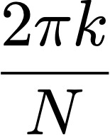

The Discrete Fourier Transform
DFT calculates amplitudes and phases of each sinusoidal component
Frequencies are linearly spaced between 0 and 2π:
Each amplitude/phase measurement is called a bin
Collectively, the N bins are called the frequency domain representation of the signal
for
Xk (frequency domain)
Frequency
Amplitude
Phase
0
4.00
0
π/8
1.64
-.875*π
3π/8
0.20
-.625*π
5π/8
0.09
-.375*π
7π/8
0.65
-.125*π
(other components are 0 or redundant)

Slide 5
The Discrete Fourier Transform
Key point: N time samples ↔︎ N frequency samples
Two different mathematical perspectives on the same signal
Inverse Discrete Fourier Transform (IDFT) converts from frequency domain to time domain
The DFT+IDFT is an exact reconstruction as long as signal length M ≤ DFT length N
x[n] (time domain)
Xk (frequency domain)
DFT
IDFT

Slide 6
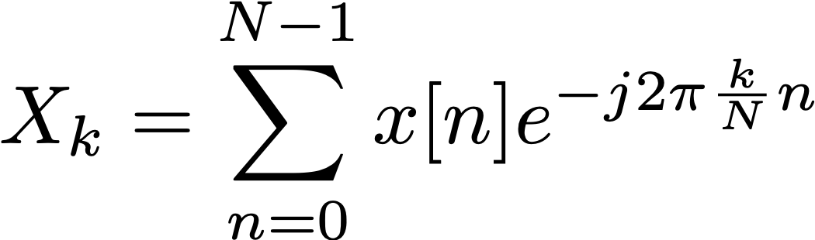
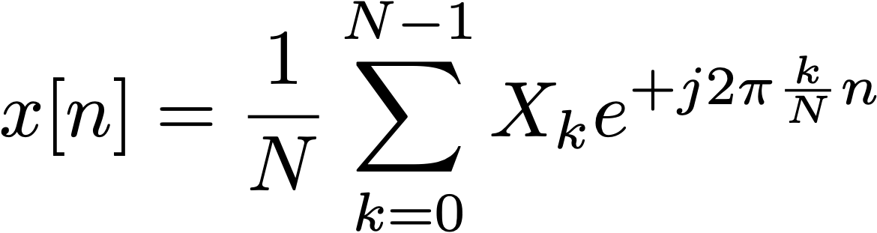
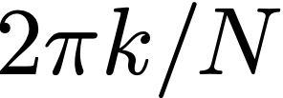
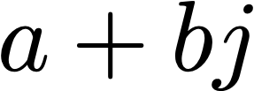
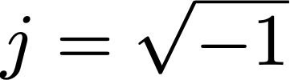
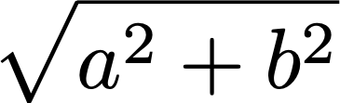

The Discrete Fourier Transform
The mathematical basis of the Discrete Fourier Transform:
N is the size of the DFT
For the FFT, N is almost always a power of 2 (the Cooley-Tukey algorithm)
Each time sample x[n] is a real number
Each frequency bin Xk is a complex number:
Magnitude of the bin is given by:
We usually use magnitude to plot a spectrum or spectrogram of a signal
Phase of the bin is given by:
DFT (FFT)
IDFT (IFFT)
sum, for all values of n between 0 and N-1...
...of signal x[n] multiplied by...
...complex exponential of frequency
time domain → frequency domain
...where k is the bin number
frequency domain → time domain
where

Slide 7


DFT magnitude and phase
Each frequency bin Xk is a complex number:
Magnitude of the bin is given by:
We usually use magnitude to plot a spectrum or spectrogram of a signal
Phase of the bin is given by:
Can also turn the calculation around:
Given magnitude M and a phase 𝜙, calculate real and imaginary components
Real component: Imaginary component:
Remember, frequency resolution depends on DFT size
Bin frequencies are spaced 2π/N apart, where 2π corresponds to the sample rate
For example, N=1024, fs = 44.1kHz: bin spacing is 43.1Hz
where

Slide 8
DFT frequency spacing
Discrete Fourier Transform bins are spaced linearly in frequency
By contrast, musical intervals are defined as ratios in frequency (e.g. 1 octave = 2x)
This means that pitch resolution of the DFT is better for higher bins
This can be a headache for many musical applications
FFT bin frequencies
(linear spacing)
f
2f
8f
16f
32f
1 octave
1 octave
1 octave
ECS7012P Music and Audio Programming • Week 10b

Slide 9
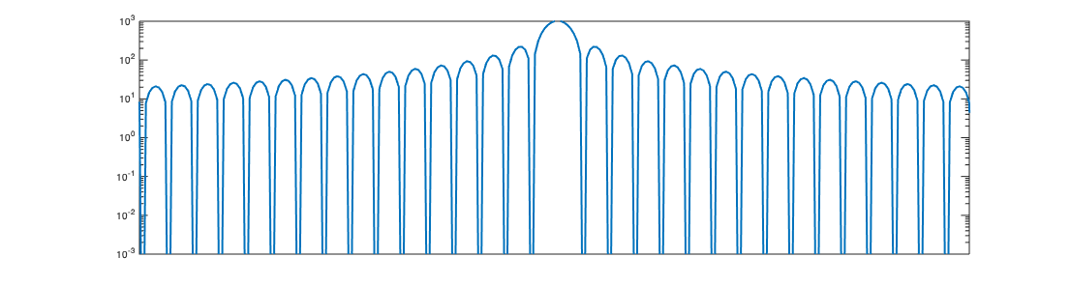
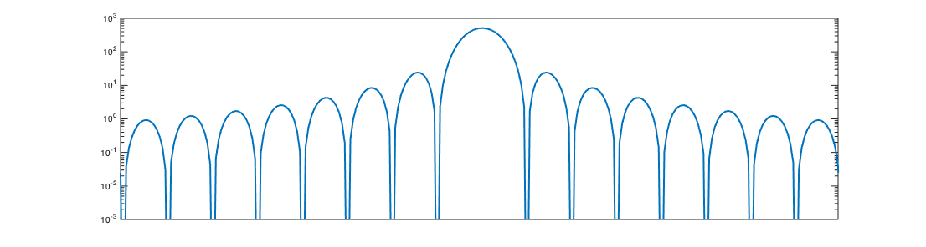
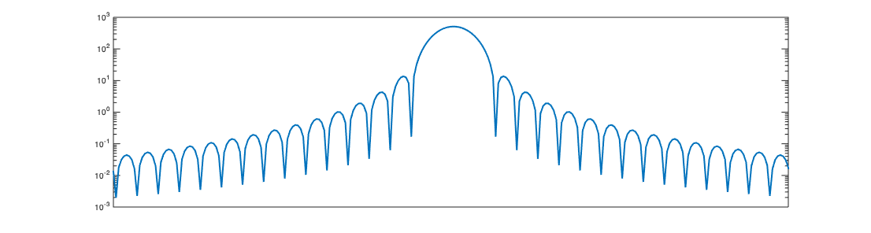
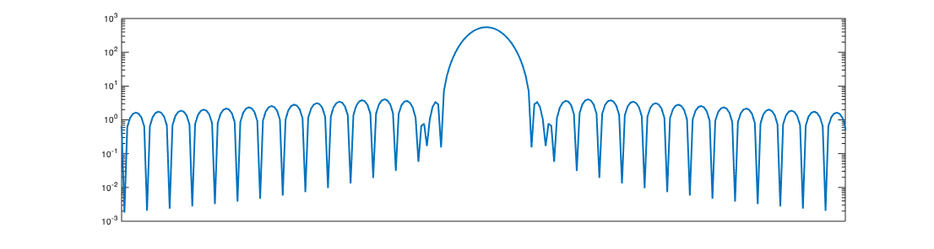
Window spectra
Rectangular
Triangular (Bartlett)
Main lobe width: 4π/N
Side lobe height: -13dB
Main lobe width: 8π/N
Side lobe height: -26.5dB
Hann
Hamming
Main lobe width: 8π/N
Side lobe height: -31.5dB
Main lobe width: 8π/N
Side lobe height: -42.8dB
→ When in doubt: use a Hann window

